Slide 1
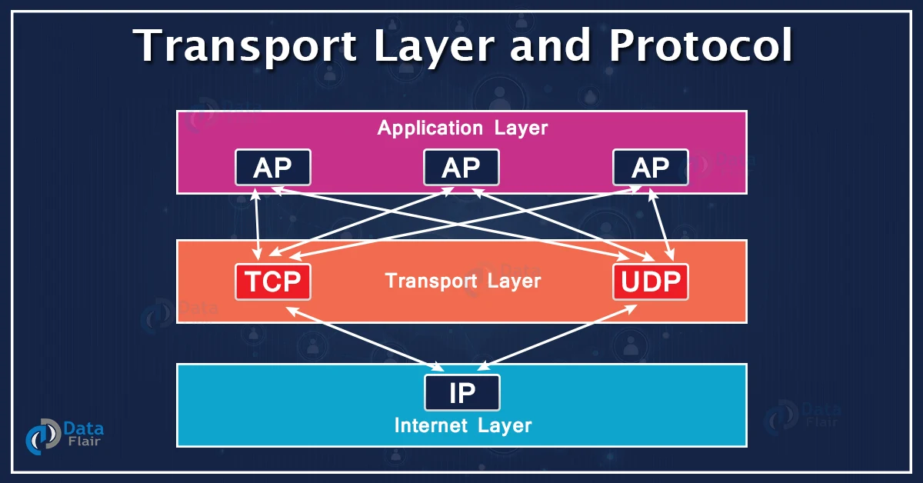
Transport Layer Unit-3

Slide 2
Introduction to Transport Layer
Definition: The transport layer is the fourth layer in the OSI model, responsible for end-to-end communication and error-free delivery of data.
Key Functions:
Segmentation and Reassembly: Breaks data into segments and reassembles it at the destination.
Error Detection and Correction: Ensures data integrity through error-checking mechanisms.
Flow Control: Manages the rate of data transmission between sender and receiver.
Importance: Enables reliable and efficient communication over a network, essential for applications requiring data integrity.

Slide 3
Relationship Between Transport and Network Layers
Transport Layer Responsibilities: End-to-end communication, error checking, flow control.
Network Layer Responsibilities: Routing, addressing, and packet forwarding.
Interaction: The transport layer relies on the network layer to deliver packets to the correct destination, while the network layer depends on the transport layer to provide the correct sequence and error-free delivery.
Eg:TCP/IP Model: TCP and UDP (Transport Layer) working with IP (Network Layer).

Slide 4
Protocols: Transmission Control Protocol (TCP) and User Datagram Protocol (UDP).
TCP
Connection-oriented
Reliable data transfer
Flow control and congestion control
UDP
Connectionless
Unreliable but faster
Used for applications like video streaming and online gaming
Applications: Email, file transfer, web browsing, multimedia streaming.

Slide 5
Different Between TCP and UDP
TCP (Transmission Control Protocol)
Connection-oriented: Establishes a connection between the sender and receiver before data can be sent.
Reliability: Ensures that data is delivered accurately and in the correct order. Lost packets are retransmitted.
Flow Control: Manages the rate of data transmission between sender and receiver to prevent a fast sender from overwhelming (great amount) a slow receiver.
Congestion Control: Adjusts the data transmission rate based on network traffic conditions to avoid congestion.
Overhead: Higher overhead due to the additional features like error checking, flow control, and congestion control.
Use Cases: Suitable for applications where reliability is crucial, such as web browsing, email, and file transfers.
UDP (User Datagram Protocol)
Connectionless: No connection is established before data is sent. Each packet (datagram) is sent independently.
Unreliable: No guarantees that data will be delivered, nor in the correct order. Lost packets are not retransmitted.
No Flow Control: No mechanism to control the data transmission rate between sender and receiver.
No Congestion Control: Does not adjust the data transmission rate based on network conditions.
Overhead: Lower overhead due to the lack of features for error checking, flow control, and congestion control.
Use Cases: Suitable for applications where speed is more critical than reliability, such as live video or audio streaming, online gaming, and VoIP.

Slide 6
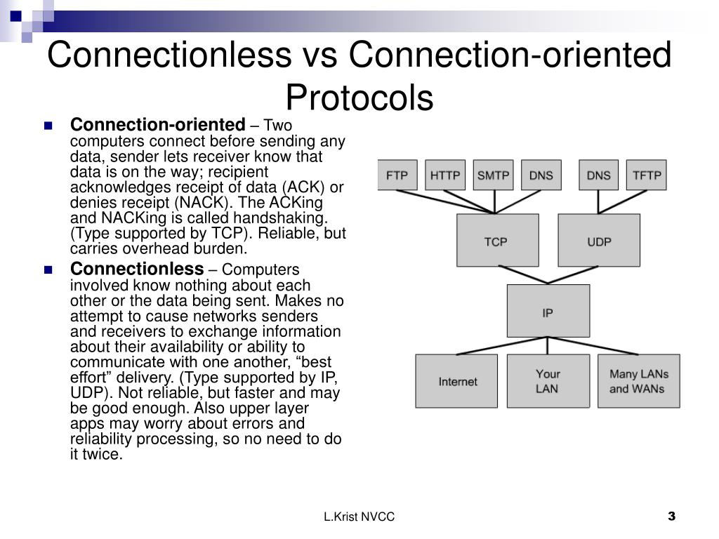

Slide 7
Multiplexing and De-multiplexing
Multiplexing: Combining multiple signals into one signal for transmission over a shared medium.
Example: Multiple applications sending data over the same network connection.
De-multiplexing: Separating a combined signal back into individual signals at the receiver's end.
Example: Receiving data from different applications and directing it to the correct application.
Importance: Efficient use of network resources, enabling multiple applications to use the network simultaneously.

Slide 8
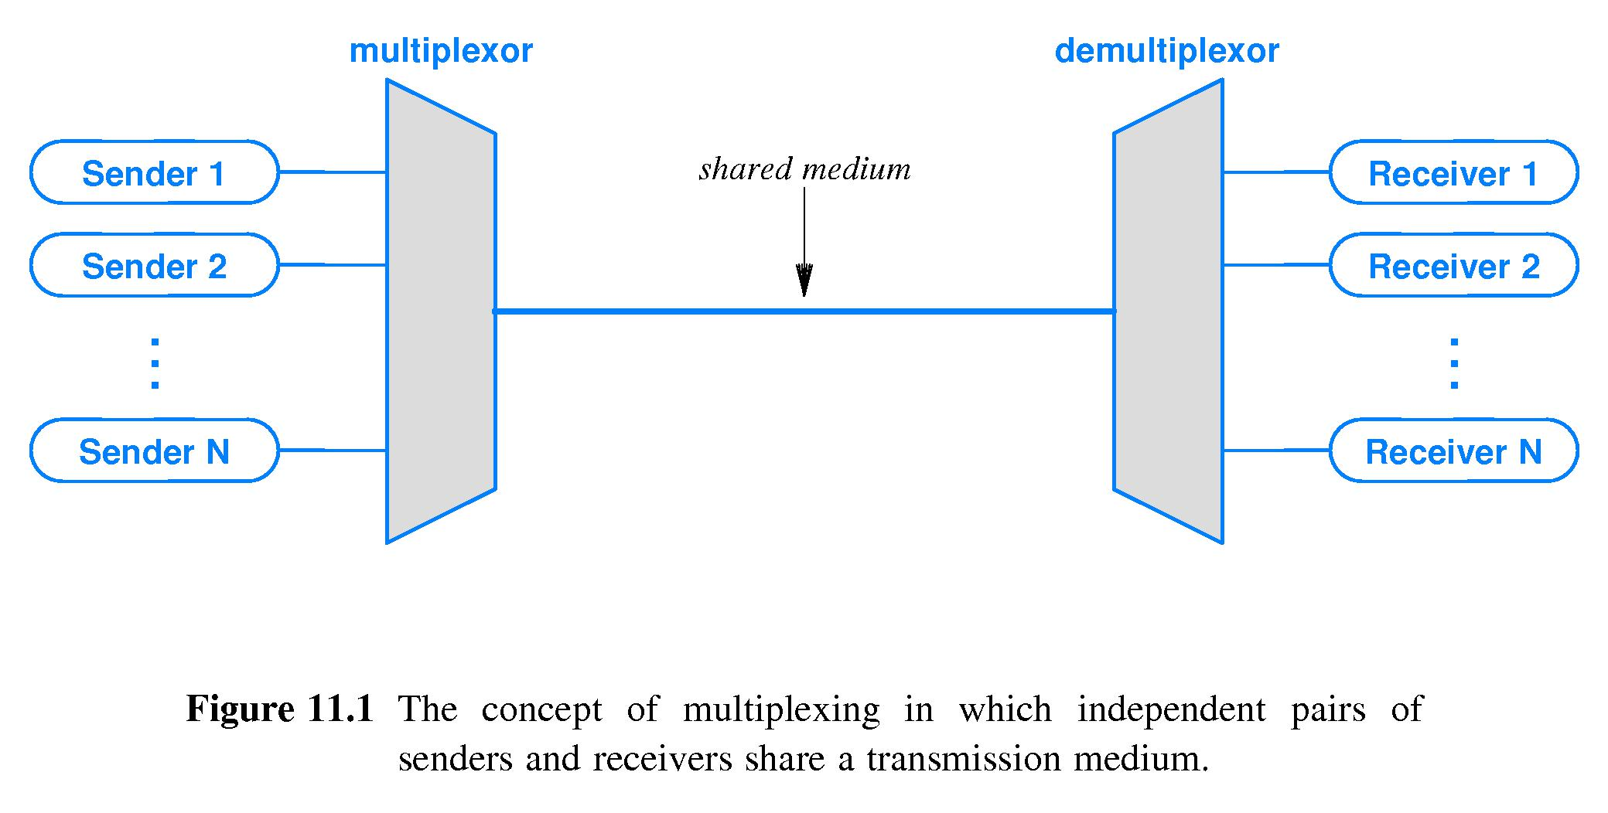

Slide 9
3.4Principles of Reliable Data Transfer
Reliable data transfer ensures data is delivered accurately and in the correct order across a network.TCP ensures reliable data transfer in internet communication.
Application: Essential for applications requiring data integrity, such as file transfers and secure communications.
Features and Characteristics:
Error detection and correction mechanisms
Acknowledgment of received packets
Retransmission of lost or corrupted packets
Sequence numbering to maintain order

Slide 10
3.4.1Go-Back-N (GBN)
Go-Back-N (GBN)
Definition: A sliding window protocol that allows the sender to transmit multiple frames before needing an acknowledgment for the first one but requires retransmission of all frames following a lost or erroneous frame.Used in some implementations of network communication protocols.
Application: Suitable for networks with relatively low error rates and where simplicity is preferred over efficiency.
Features and Characteristics:
Single acknowledgment for multiple frames
Retransmission of all frames after a lost or corrupted frame
Simplicity in implementation
Inefficiency in high error rate scenarios

Slide 11
3.4.2Selective Repeat (SR)
Selective Repeat (SR)
Definition: A sliding window protocol where only the erroneous or lost frames are retransmitted, improving efficiency over GBN. Utilized in advanced data communication systems to optimize bandwidth usage.
Application: Useful in networks with higher error rates and where bandwidth efficiency is critical.
Features and Characteristics:
Individual acknowledgment for each frame
Selective retransmission of only lost or corrupted frames
More complex implementation than GBN
Efficient use of bandwidth

Slide 12
3.5Connection-Oriented Transport: TCP
TCP is a connection-oriented protocol that establishes a connection before data transfer begins, ensuring reliable and ordered delivery.
Commonly used in web browsing, email, and file transfers.
Application: Critical for applications requiring reliable data transmission, such as HTTP, FTP, and SMTP.
Features and Characteristics:
Establishes a connection before data transfer
Uses sequence numbers and acknowledgments
Provides error detection and correction
Manages flow control and congestion control

Slide 13
3.5.1Round-Trip Time Estimation and Timeout
Definition: RTT is the time it takes for a signal to travel from the sender to the receiver and back. Accurate RTT estimation is crucial for setting appropriate timeouts. TCP uses RTT estimation to set retransmission timeouts.
Application: Ensures efficient data transmission and minimizes delays in network communication.
Features and Characteristics:
Dynamic adjustment of timeouts based on network conditions
Prevents premature retransmissions
Ensures timely retransmission of lost packets
Enhances overall network performance

Slide 14
Reliable Data Transfer
Reliable Data Transfer (RDT): Ensures that data sent from one host to another arrives correctly and in order.
Critical Data Transmission Used in applications like financial transactions, email, and file transfers where data integrity is crucial.Error-sensitive Communication Ensures error-free communication in network protocols.
Features
Acknowledgments (ACKs)Receiver sends an ACK to confirm the receipt of data.
Sequence Numbers Used to order packets correctly.
Retransmission Lost or corrupted packets are retransmitted.
Error Detection Checksum and other techniques to detect errors in transmission.
Flow Control Manages the rate of data transmission based on the receiver’s capacity.
Congestion Control Prevents network congestion.

Slide 15
Flow Control:
A technique to prevent the sender from overwhelming the receiver with too much data at once.
Data Integrity Ensures all data sent is received and processed properly.Efficient Network Usage Prevents congestion and maximizes throughput.Communication Protocols Used in various protocols like TCP to maintain data flow efficiency.
Features
Sliding Window Protocol:
Window Size: Limits the amount of data the sender can transmit before needing an acknowledgment.
Dynamic Adjustment: Window size can change based on network conditions.
Receiver Window (rwnd): Indicates how much data the receiver can accept.
Credit-Based Flow Control: Receiver grants "credits" to the sender, indicating the amount of data it can handle.
Buffer Management: Ensures that the receiver’s buffer is not overflowed, preventing data loss.

Slide 16
Thank You

